Slide 1
Graphs - Algorithms and Mining
(DSE** ZG521)

Slide 2
Module I

Slide 3
Course Introduction
COURSE Objectives:
  CO₁: To introduce handling graph data at large scale
  CO₂: To introduce graph mining algorithms and their applications
  CO₃: To enable students to identify and formulate graph mining problems formally, providing solutions
  CO₄: To enable students to evaluate various possible graph mining solutions for a given problem

Slide 4
Resources
TEXT BOOKS (T1 & T2):
Social Media Mining - An introduction, Reza Zafarani, Mohammad Ali Abbasi, Huan Liu , Cambridge University Press , 2014 [ http://dmml.asu.edu/smm/SMM.pdf - Open Access]
Not all topics are covered in one text/reference book.
* Research Papers will be used for most of the topics.
* Most of the contents are theoretical, but their practical application will be explained.
* Research Paper will also be provided to you, for your better understanding

Slide 5
Resources
REFERENCE BOOKS (R):
(R1) Agarwal Charu C. and Wang Haixun, “Managing and Mining Graph Data” , Springer; 2010 edition.
(R2) Jure Leskovec, Anand Rajaraman, Jeff Ullman. “Mining of Massive Datasets”. Book 2nd edition. Cambridge University Press.
(R3) Tan P. N., Steinbach M & Kumar V. “Introduction to Data Mining” Pearson Education, 2006

Slide 6
EVALUATION SCHEME
EC No | Component & Nature | Duration | Weightage | Date, Time
1. | Quiz 1 | - | 5% (Best of the Two)
1. | Quiz 2 | -
1. | Assignment 1 | - | 25%
2. | Mid-Semester Test (Closed Book) | 2 hours | 30%
3. | Comprehensive Exam (Open Book) | 3 hours | 40%

Slide 7
Few Requests
Email etiquettes.
No “reply to all”; unless & until unavoidable!
No Request to timeline extension, with the reason of being working professionals.
Continuous reading of papers & books.

Slide 8
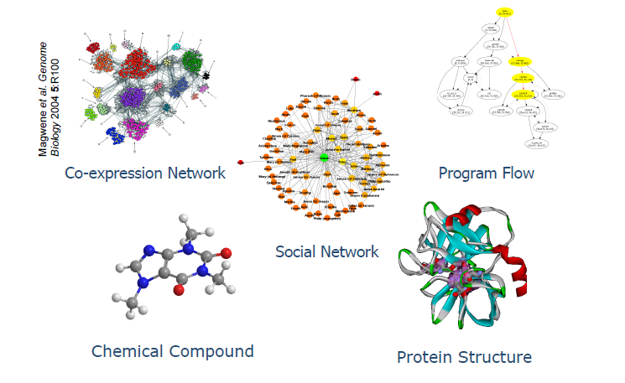
Various type of Graph Data for Graph Mining

Slide 9
Course Outline
Introduction to the Graphs
  Preliminaries
Graph Mining Applications
Overview of Graph mining Algorithms
  Graph Data Management Algorithms
    Indexing
    Querying
      Reachability
      Matching
      Searching
      Summarization
  Dynamics of Dynamic Graphs (Time Evolving Graphs)
    Densification
    Radius & Diameter of graph

Slide 10
Course Outline ….
Graph Mining Algorithms
  Pattern Mining
  Clustering
    Node Clustering
    Graph Clustering
  Classification
    Label Propagation
    Graph Classification
  Graph Compression
  Other important topics
    (graph model, laws, graph dynamics, social network analysis, visualization, summarization, graph clustering, link analysis, …)

Slide 11
Prerequisite
Graph Terminologies.
  Nodes
  Edges
  Degree and Degree distribution
  Weighted - unweighted,
  Storage of graph: Matrix-list..
  Tree, Forest, Spanning tree
  Traversal: DFS, BFS
  Paths, Connected – disconnected

Slide 12
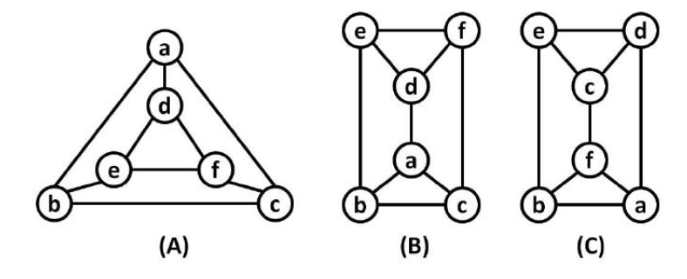
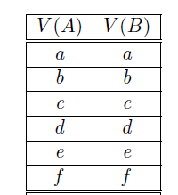
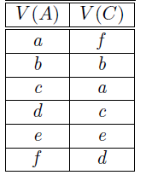
Prerequisite
NP Complete Problems.
Graph Isomorphism.
Graph Matching.
  Edit Distance
Sub Graph Isomorphism.
Graph Summarization
  Google Maps example
Graph Partitioning
  Cut Vertex
  Cut Edge
  Bipartite graph

Slide 13
Prerequisite….
Random Walk
Cliques
Planar & Non Planar Graphs.
Pattern Matching.
Disk Resident Graphs.
  Why the algorithms using random edges/nodes are not suitable for disk resident graphs
Graph Connectivity,
  Max Flow - Min Cut
Connected Components
  Largest Connected Components
Lowest common ancestor.
……

Slide 14
Topics for Assignments/Presentation
Graph Isomorphic algorithms
Diameter & Reachability calculation algorithm
Topic sensitive page rank algorithm
SimRank algorithm
Kerninghan-Lin algorithm & The Girvan-Newman Algorithm
gSpan Algorithm

Slide 15
Reference
D. Cook, L. Holder, Mining Graph Data, John Wiley & Sons Inc, 2007.
Agarwal Charu C. and Wang Haixun, “Managing and Mining Graph Data”, 2010.

Slide 16
Thank You

